Slide 2
Nasttpo Annual Training & WORKSHOP
Salt Lake City, Utah
Presentation by
RubyDawn Manning
Western Plains Emergency Services

Slide 3
RubyDawn Manning
20+ Year Career
20 Fire Service/Emergency Management
Western Plains Emergency Services
Emergency Manager
Paiute Shoshone Tribe, Fallon
WMD Instructor for Center for Domestic Preparedness
HAZMAT/WST Instructor for Alabama Fire College
Idaho Volunteer Fire & Emergency Services Association Board Member
TransCAER State Representative (ID/NV)
Freedom Riders Training Institute
NASTTPO Board Member and Tribal Rep

Slide 4
Discussion agenda
TERC’s
TERC & LEPC’s
MOA’s MOU’s
Tools For Success
Incidents
Jurisdictional & Geographic Relations
Training Opportunities

Slide 5
TERC
Tribal Emergency Response Commissions/Committees
Stakeholders
Tribal Business Council Approval
Tribal Planning and Coordination
EOP Planning and Reporting

Slide 6
TERC & LEPC’s
Seats at the Planning Table
Results in Collaborative Efforts
Jurisdictional Relations Increases Response Capabilities
MOA and MOU Legal discussions and Dispatching

Slide 7
MOA’s and MOU’s
Memorandum of Agreements and Understanding
Cost Efficiency
Unified Command Facilitated Through Familiarization
Emergency Operations Plans and TERC’s & LEPC’s

Slide 8
Regional Cooperation

Slide 9
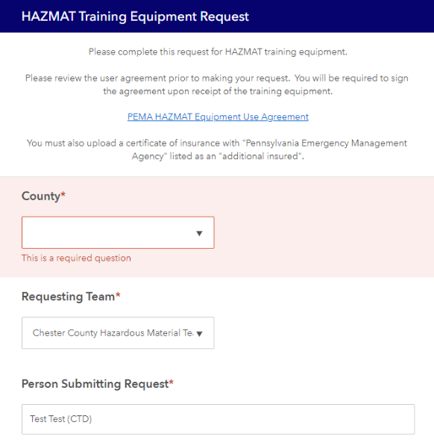
Resource Sharing
Increased Capabilities
Equipment Utilization
Open Communication

Slide 10
Hazardous Commodity flow studies
Identify High Priority Transportation Corridors
List High Priority Hazardous Materials in Region
EHS
Proximity
Aids in Mitigation
Maps and Planning Capabilities
Notification Processes in Maps

Slide 11
Hazardous Commodity flow studies

Slide 12
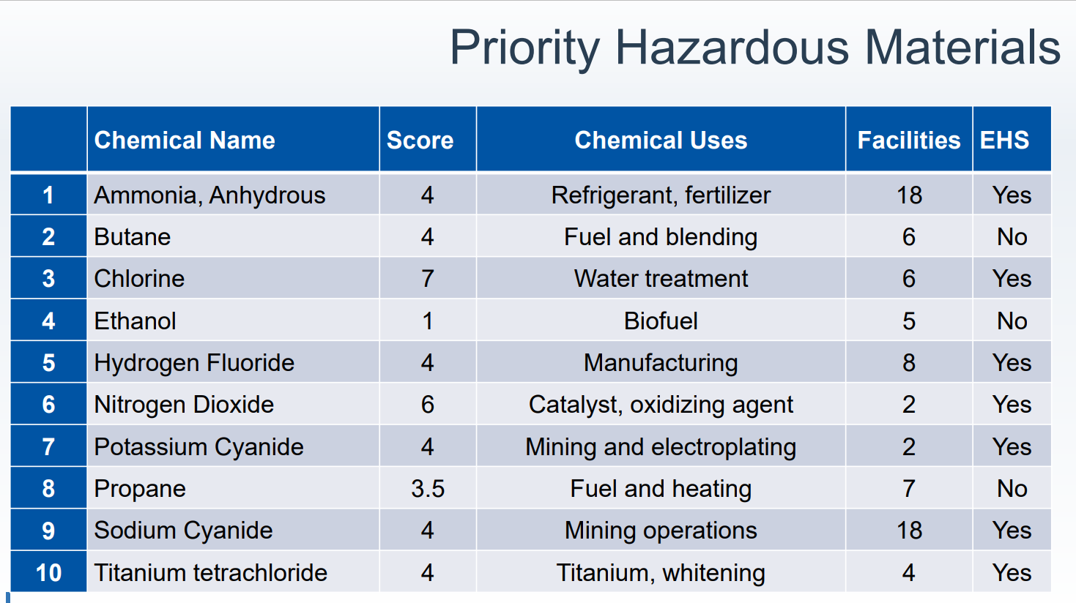
Hazardous Commodity flow studies

Slide 13
Hazardous Commodity flow studies

Slide 14
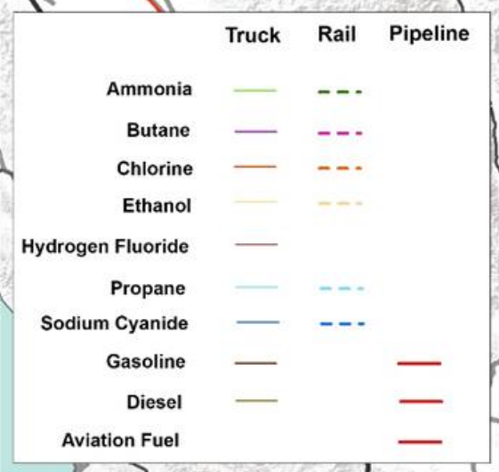
Hazardous Commodity flow studies

Slide 15
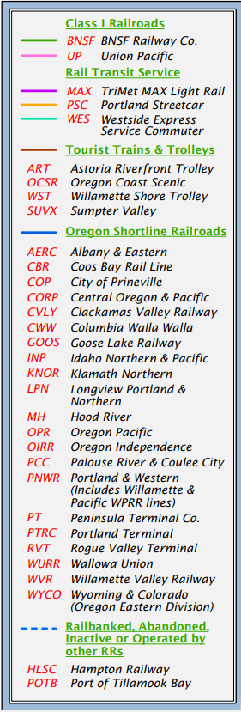
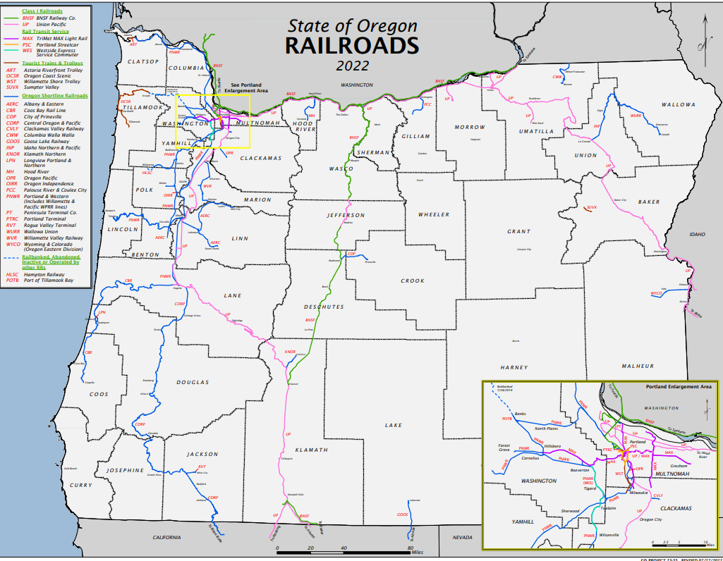
Oregon railroads

Slide 16
Hazardous Materials Incidents
PHMSA Report 2022 Oregon
2022 497 Incidents
$206,945
PHMSA Report 2023- Oregon
2023 125 Incidents
$96,260

Slide 17
Jurisdictional & geographic relationships
From Dysfunction to Cohesive Operations
Large Scale Response Capabilities
Effective Planning
Stakeholder Collaborations
Engaging Resources
Disaster and Emergency Response Exercises
Unified Command
Training

Slide 18
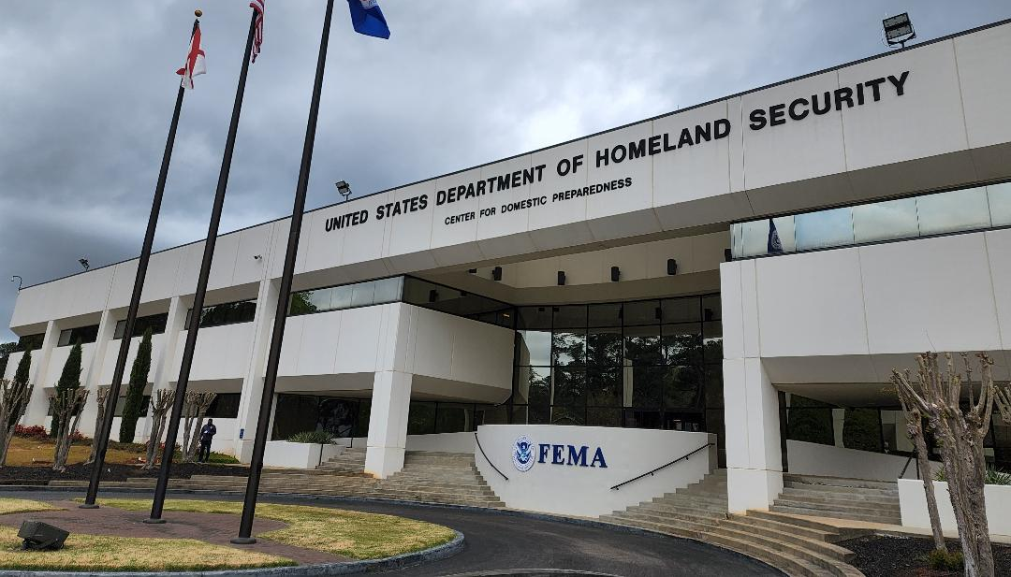

Slide 19
Center for domestic preparedness
Resident Training
Hazmat
Law Enforcement
First Receivers/Medical
Emergency Management
Non-Resident Training
Virtual Instructor-Led Training
Independent Study
Tribal Training Week
National Preparedness Symposium
COBRA

Slide 20
Alabama fire college
Multiple HazMat
Illicit Drug Response Awareness
Incident Command System
WMD & All-Hazards Awareness
MCI Triage Awareness
Responder Safety Awareness
HAZWOPER & Annual Refresher
Radiological / Nuclear Awareness
Workplace Safety Training Program: Ted Krayer (205) 296-3609
Training Specialist: Ben Caffee BCAFFEE@ALABAMAFIRECOLLEGE.ORG

Slide 21
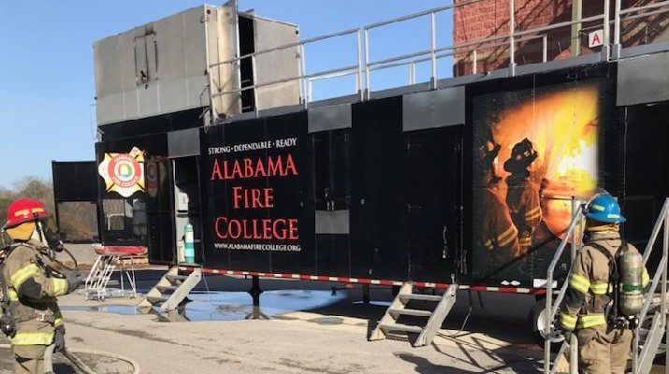
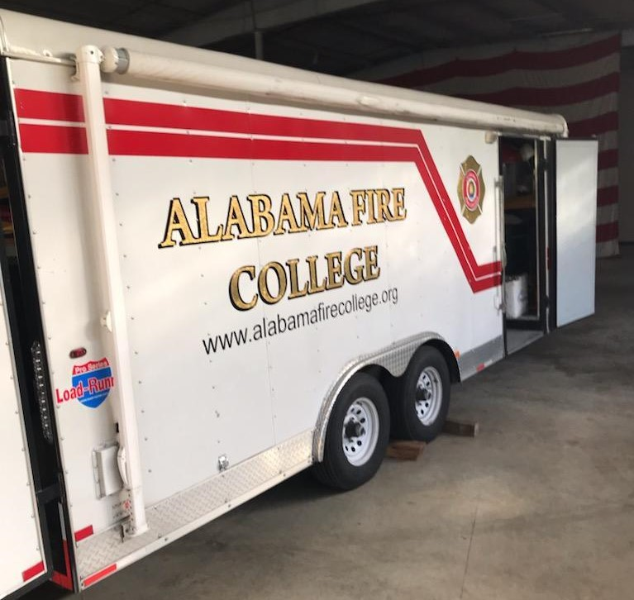
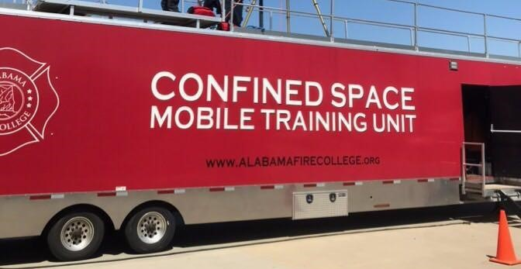
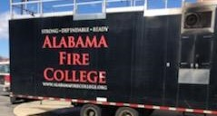
Alabama Fire College

Slide 22
Transcaer
The TRANSCAER Mission:
Promote safe transportation and handling of hazardous materials
Educate and assist communities regarding hazardous materials
Aid community emergency response planning

Slide 23
10 National Organizations Sponsoring TransCAER

Slide 24
Questions & Comments

Slide 25
Thank you!
RubyDawn Manning
Western Plains Emergency Services
(775)340-5167
Red_Elk_Woman@yahoo.com

